Slide 1
Industry resource toolkit Article 1: Australia’s national biosecurity system
This graphic pack support the Industry resource toolkit – an educational series aimed at providing Plant Health Australia (PHA) Plant Industry Members with a resource toolkit containing information on national response arrangements under the Emergency Plant Pest Response Deed (EPPRD).
The toolkit is a collection of 12 articles developed by Plant Health Australia to help Plant Industry Members educate their own members about the Emergency Plant Pest Response Deed (EPPRD).
This pack supports the content contained in Article 1, Australia’s national biosecurity system. The graphics include:
the activities undertaken overseas, at our borders, and within Australia
the three national biosecurity response agreements in Australia
icons that depict Emergency Plant Pests.
Use the graphics to:
customise the colours to suit your organisation’s branding
create images for social media, website, newsletters, and other formats.
incorporate them into your member training and educational programs
in your promotional material as brochures and flyers.
Learn more about customising the graphics contained in this pack:
how to add a colour palette in PowerPoint to match your organisation's branding
how to change the colour of a diagram in PowerPoint
how to save a PowerPoint slide as a .png or .jpeg file.
Find out more about the Industry resource toolkit.

Slide 2
Australia’s national biosecurity system
OVERSEAS
Risk analysis and import approvals (inc management and communication). Near neighbour surveillance and capacity development
Export market access negotiations
Offshore assessment, audit and verification
International standards development
Capacity building in overseas countries
Gathering global pest intelligence
AT THE BORDER
Inspection and monitoring
Enforcement and compliance
Implementation of risk management system
Policy implementation
Education and awareness
WITHIN AUSTRALIA
Monitoring and surveillance
National coordination and response to pest incursions
Domestic quarantine movement restrictions
Pest management
Breeding of resistant varieties
Emergency preparedness activities
Simulation exercises
Education and awareness
Preparedness measures
Farm biosecurity
Article 1: Australia’s national biosecurity system
Caption: Protecting Australia from plant pests and diseases through activities undertaken overseas, at our borders, and within Australia.

Slide 3
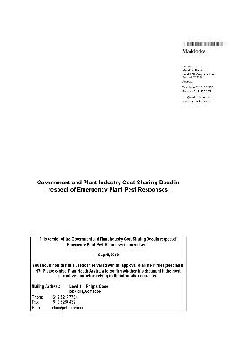
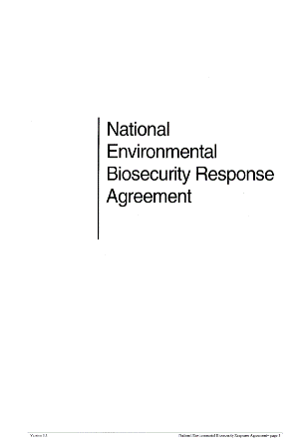
Emergency response arrangements
EMERGENCY PLANT PEST RESPONSE DEED
Emergency Animal Disease Response
National Environmental Biosecurity Response Agreement
Article 1: Australia’s national biosecurity system
Caption: There are three national biosecurity response agreements in Australia

Slide 4
What is an EPP?
An EPP must be a…
An EPP must have an impact on…
[Recommended: Replace the crop icon with one relevant to your industry]
INSECT
MITE
CROPS
PATHOGEN
NEMATODE
EDIBLE
FUNGI
SNAIL
WEED
BEES
Article 1: Australia’s national biosecurity system
Caption: The EPPRD is only applied where the pest or disease has been identified as an Emergency Plant Pest.
Note: this can also be found in Article 3 supporting graphics pack.

